Slide 1
CTSM Mini Workshop
Jie Hu
08/29/2024
Department of Soil & Environmental Sciences

Slide 2

Contents of this workshop
Intro (what/why/how)
Hands-on tutorial
Additional resources

Slide 3
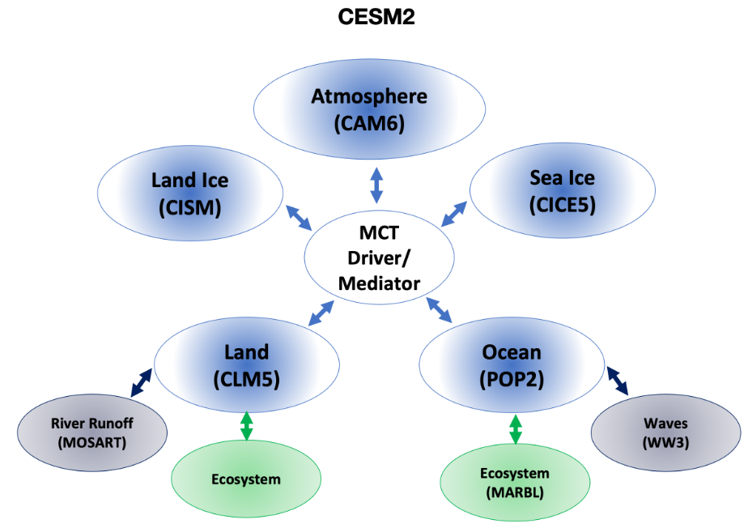
What is CTSM?
Community Terrestrial System Model / Community Land Model
the Land component of the Community Earth System Model
https://www.cesm.ucar.edu/models/clm

Slide 4
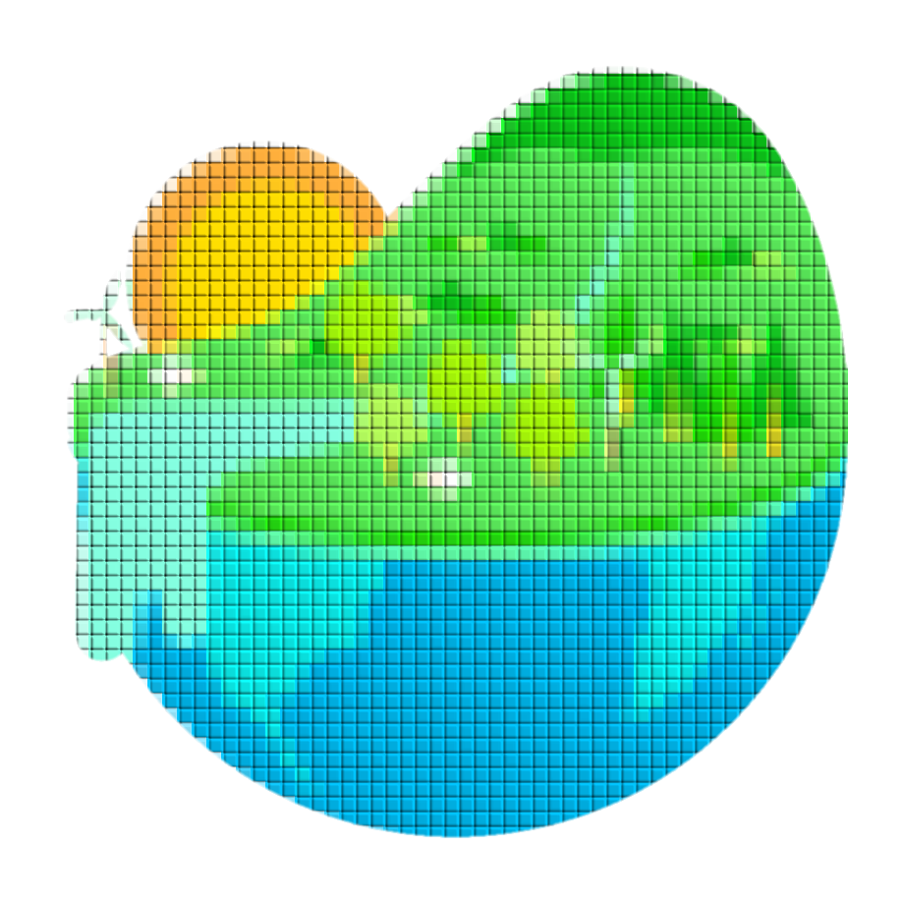
What is CTSM?
Formalizes & quantifies land surface processes
f(soil methane emission)
f(canopy carbon fixation)
f(plant transpiration)
…

Slide 5

What is CTSM?
Formalizes & quantifies land surface processes
Understand & predict how natural & human changes affect climate
soil compaction
crop irrigation
fire intensity
…

Slide 6
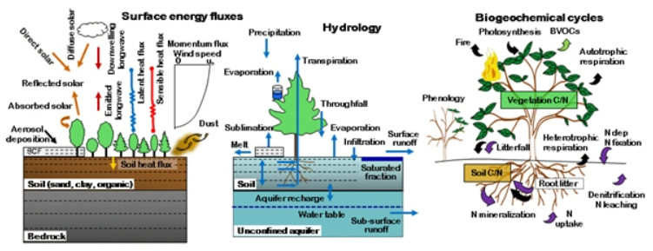
Why is CTSM important/useful?
Experiment based on your research interest
biophysics, hydrology, biogeochemistry, agroecology, …

Slide 7
Why is CTSM important/useful?
Experiment based on your research interest
Evaluate & advance our knowledge of the land surface processes
model estimation vs. observations
new parameterization/equation, …
f(soil methane emission)
f(canopy carbon fixation)
f(plant transpiration)
…

Slide 8
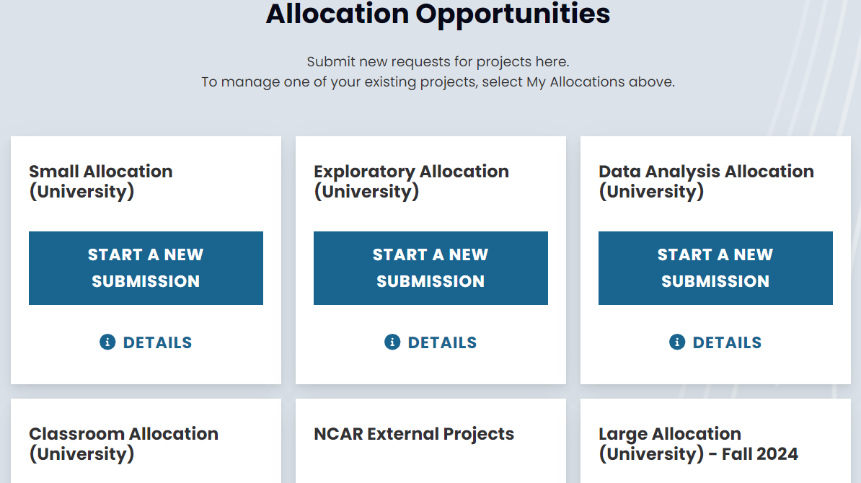
How to use CTSM?
Conventional (“hard mode”)
Apply for NCAR computing resources
Register account
Apply for allocation (NSF/exploratory)
https://arc.ucar.edu/xras_submit/opportunities

Slide 9
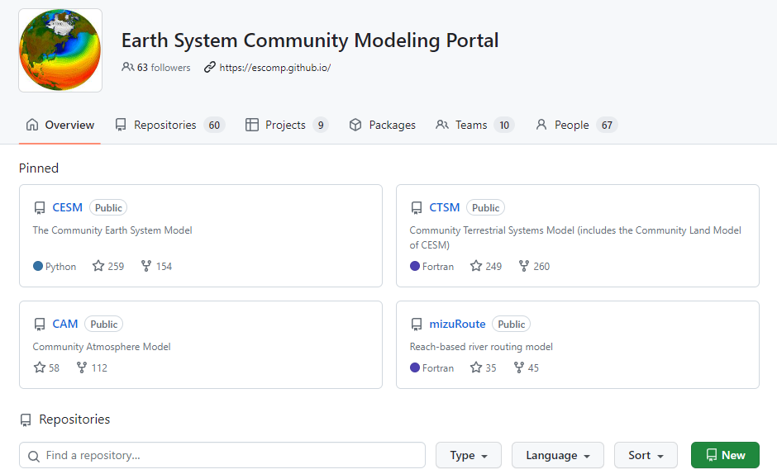
How to use CTSM?
Conventional (“hard mode”)
Apply for NCAR computing resources
Register account
Apply for allocation (NSF/exploratory)
https://arc.ucar.edu/xras_submit/opportunities
Download CTSM code from GitHub
Select the model version
Download the code and checkout in your NCAR file space
https://github.com/ESCOMP/CTSM

Slide 10
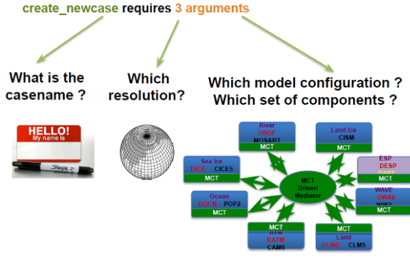
How to use CTSM?
Conventional (“hard mode”)
Apply for NCAR computing resources
Register account
Apply for allocation (NSF/exploratory)
https://arc.ucar.edu/xras_submit/opportunities
Download CTSM code from GitHub
Select the model version
Download the code and checkout in your NCAR file space
Run your experimental simulation
Create a case, setup, build, and submit it
https://github.com/ESCOMP/CTSM

Slide 11
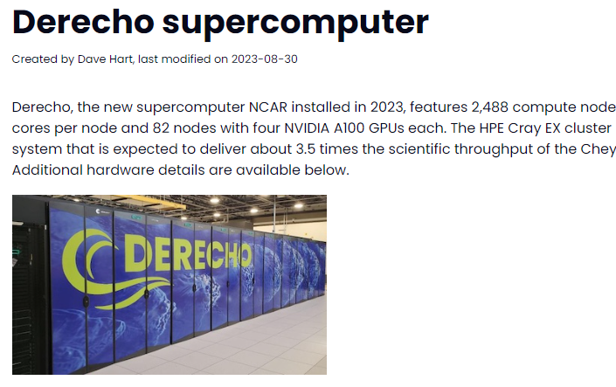
How to use CTSM?
Conventional (“hard mode”)
requires knowledge/experience in
Terminal window
Unix commands
NCAR HPC (High Performance Computing) assets
CIME (Common Infrastructure for Modeling the Earth)
Notes:
filespace, computing core-hours

Slide 12
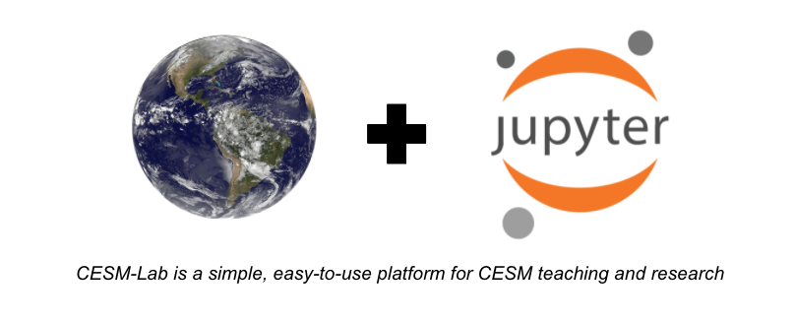
How to use CTSM?
Containerized (“easy mode”) → NCAR-NEON system
Designed to run single-point simulations on supported NEON sites
Portable : Containers can run almost everywhere (Mac, Windows, Linux)
Pre-configured : No installation or porting required on containers
Standardized : All users get the same environment, NCAR allocation not required

Slide 13
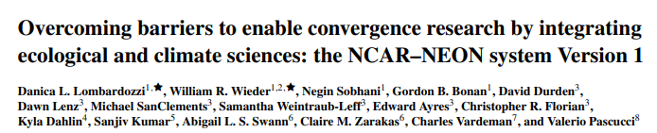
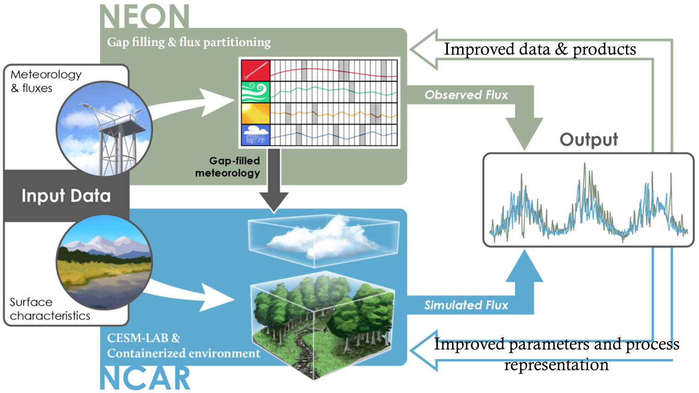

Slide 14
Hands-on tutorial
Jupyter Book available online
https://ncar.github.io/ncar-neon-books/intro.html
Workflow of today
Step 1: Download & install Docker on your laptop
Step 2: Download the CTSM Docker container
Step 3: Create a location for the container
Step 4: Start the container
Step 5: Connect to the NEON site simulation tutorial
Step 6: Run the NEON site simulation

Slide 15
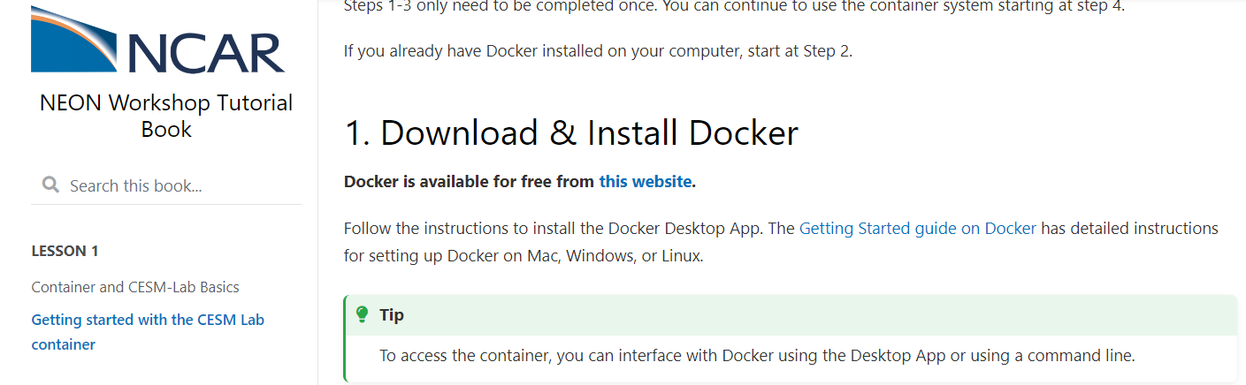
Step 1: Download & install Docker on your laptop
In the Jupyter Book…

Slide 16
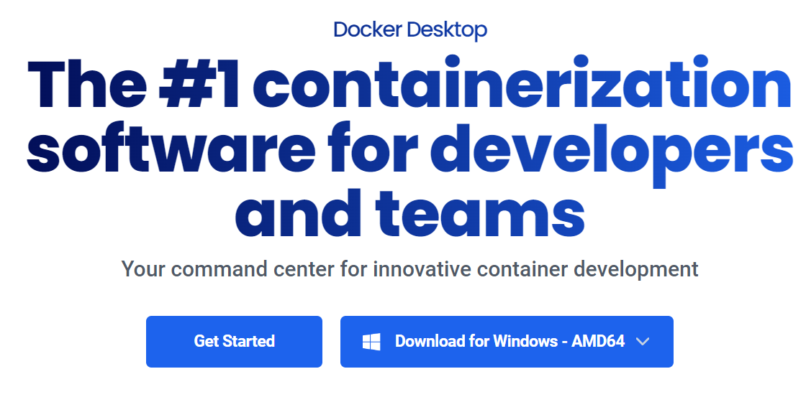
Step 1: Download & install Docker on your laptop
In the docker webpage…
This should appear as your laptop operating system, mine is Windows

Slide 17
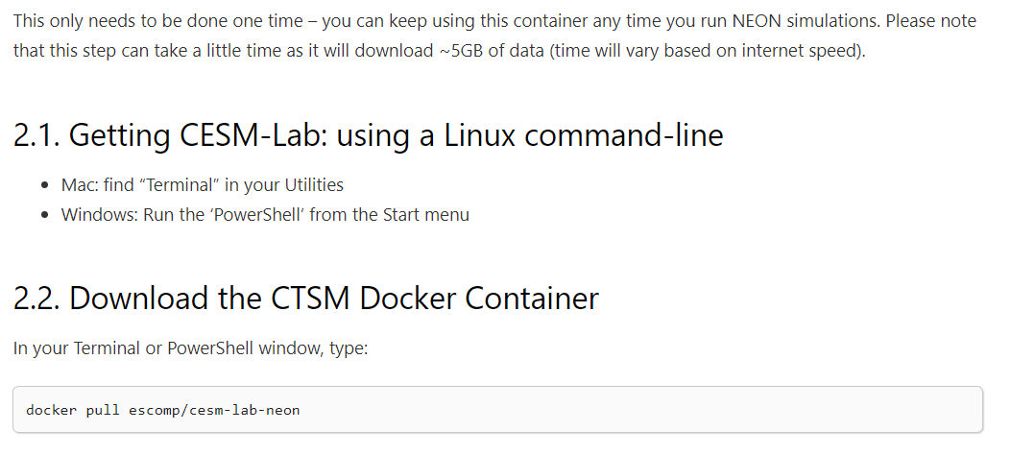
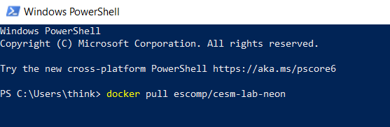
Step 2: Download the CTSM Docker container
In the Jupyter Book…

Slide 18
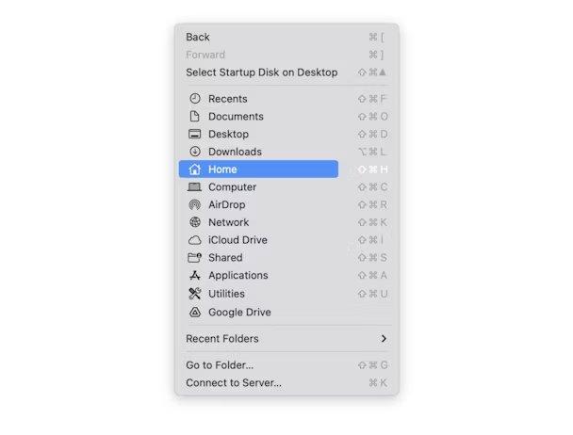
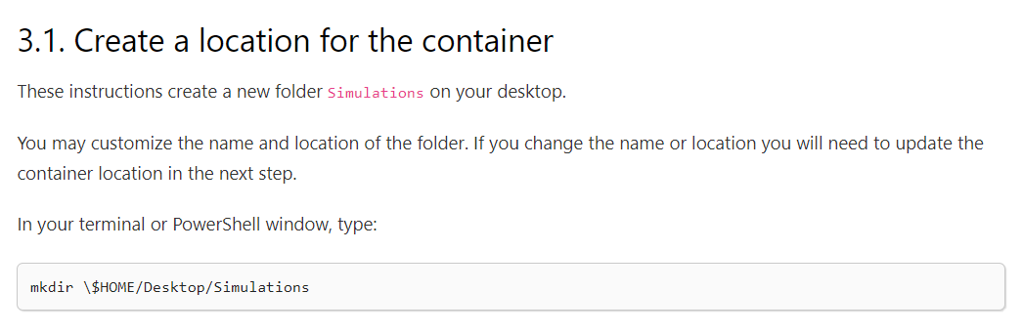
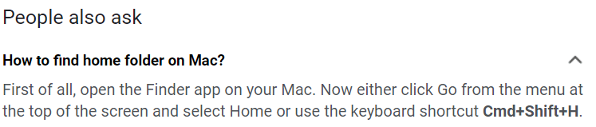
Step 3: Create a location for the container
In the Jupyter Book…
mkdir – make/create directory
You might need to replace “$HOME” with your true home directory or another drive that you like,
such as “mkdir \$HOME/D:/Simulations”

Slide 19
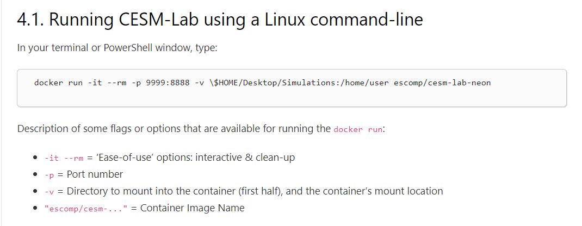
Step 4: Start the container
In the Jupyter Book…
the “$HOME” that you used in the last step

Slide 20
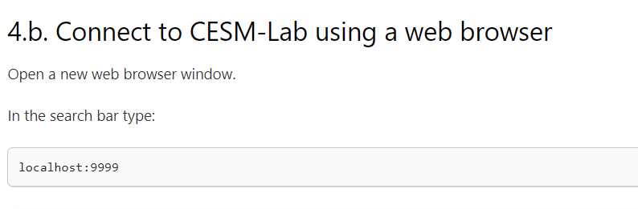
Step 5: Connect to the NEON site simulation tutorial
In the Jupyter Book…

Slide 21
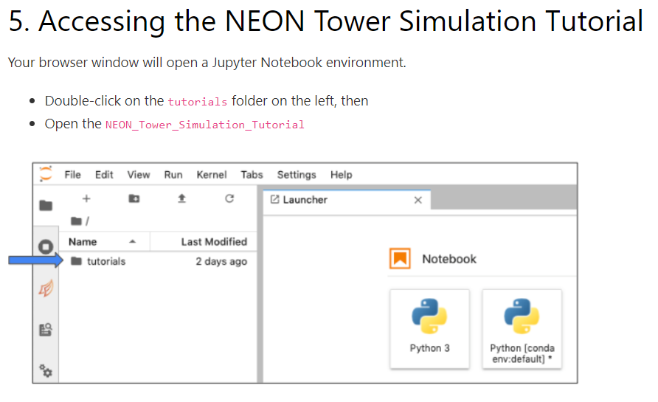
Step 6: Run the NEON site simulation

Slide 22
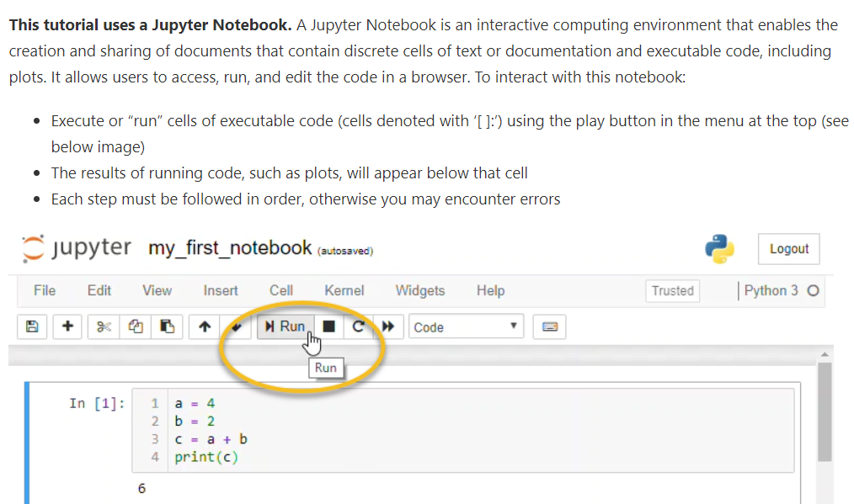
Step 6: Run the NEON site simulation

Slide 23
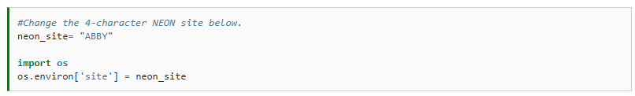
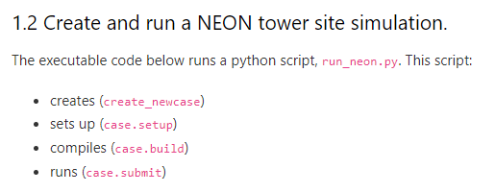
Step 6: Run the NEON site simulation

Slide 24
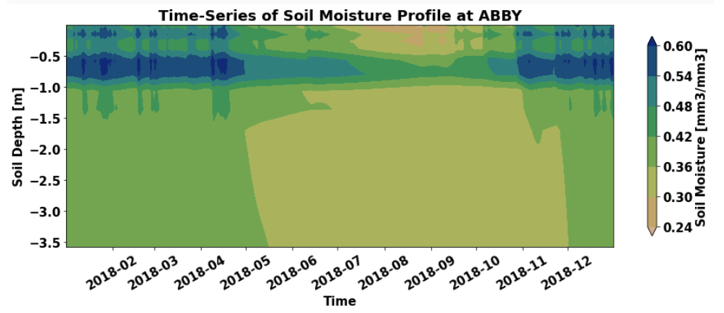
Step 6: Run the NEON site simulation
After the simulation, you should be able to plot out the model result

Slide 25
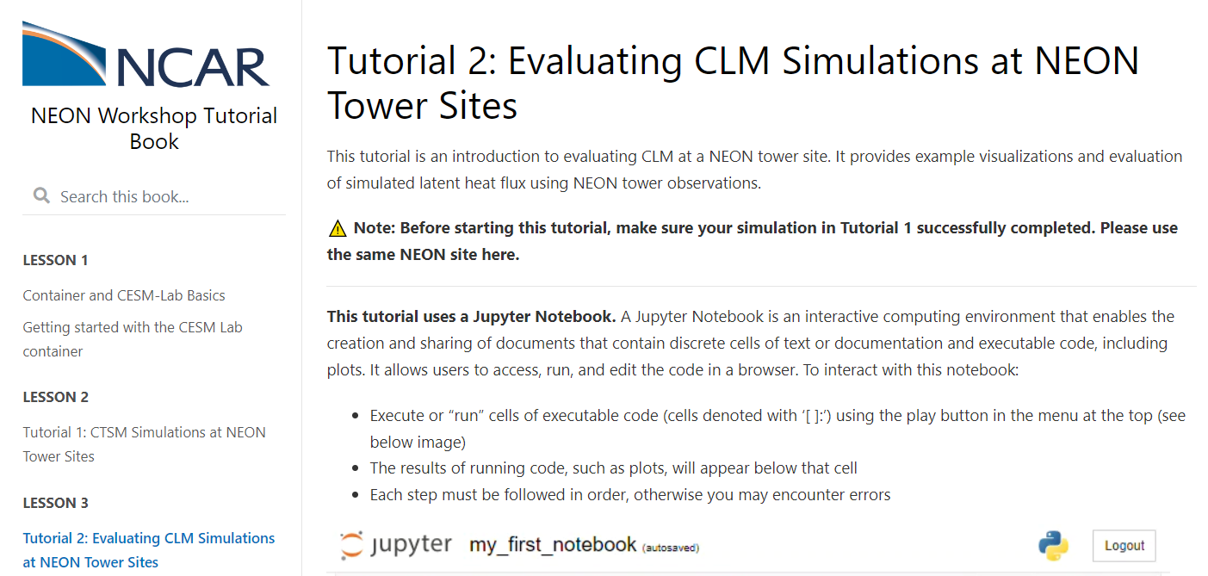
If you have extra time…
Go ahead and try tutorial 2 as well

Slide 26
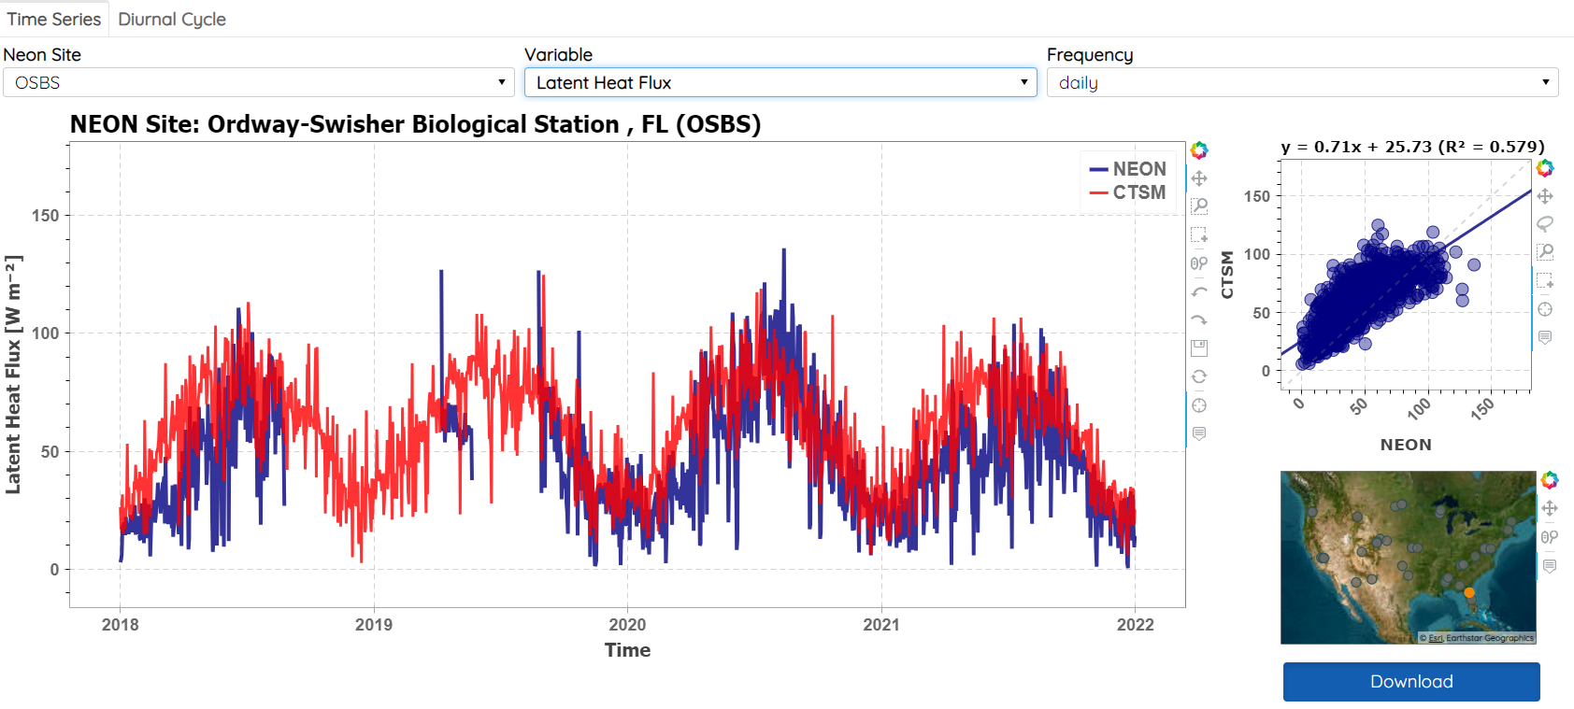
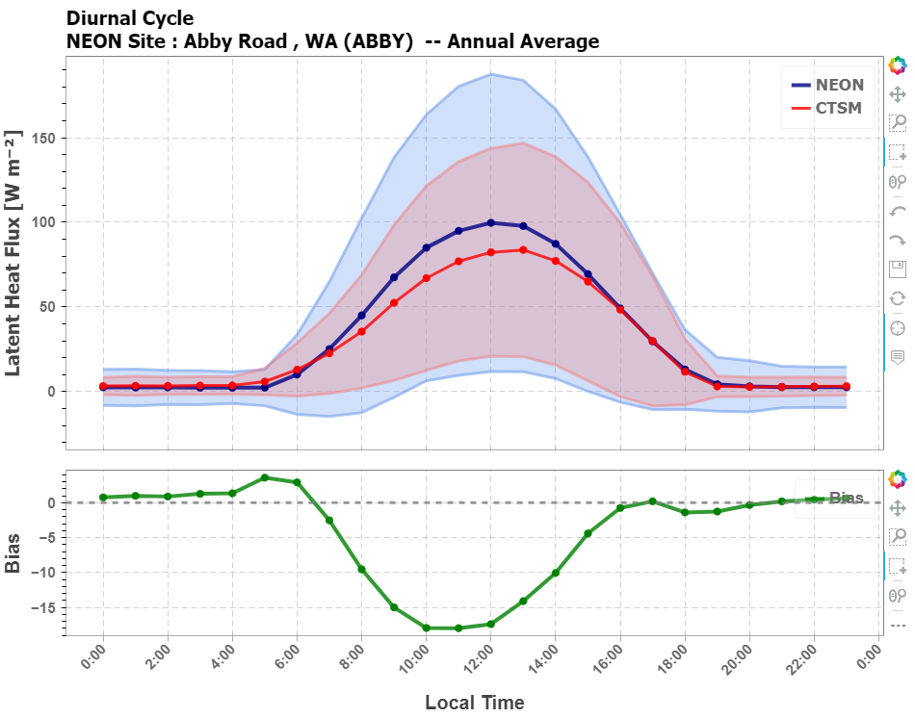
Additional resources
Interactive visualization using NEON-NCAR system
https://ncar.nationalsciencedatafabric.org/neon-demo/v1/

Slide 27
Additional resources
Interactive visualization using NEON-NCAR system
https://ncar.nationalsciencedatafabric.org/neon-demo/v1/
CESM tutorials (do need NCAR allocation) for regional/global simulation
https://ncar.github.io/CESM-Tutorial/README.html
CTSM documents
User’s Guide (https://escomp.github.io/ctsm-docs/versions/master/html/users_guide/index.html)
Technical Note (https://escomp.github.io/ctsm-docs/versions/master/html/tech_note/index.html)

Slide 28
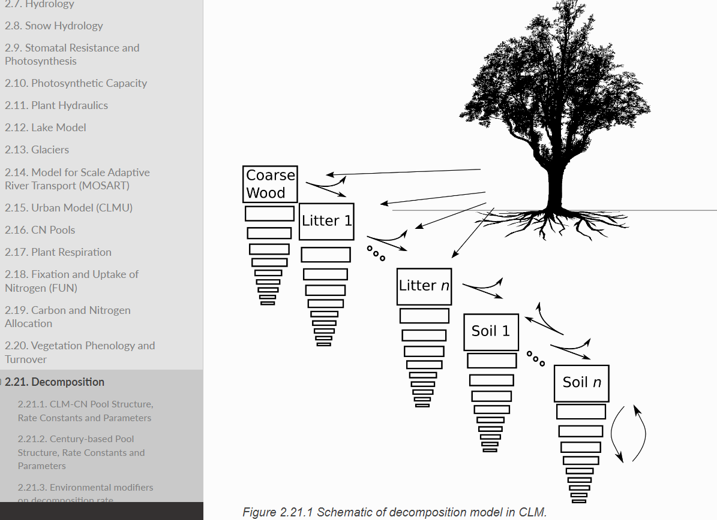
Additional resources

Slide 29
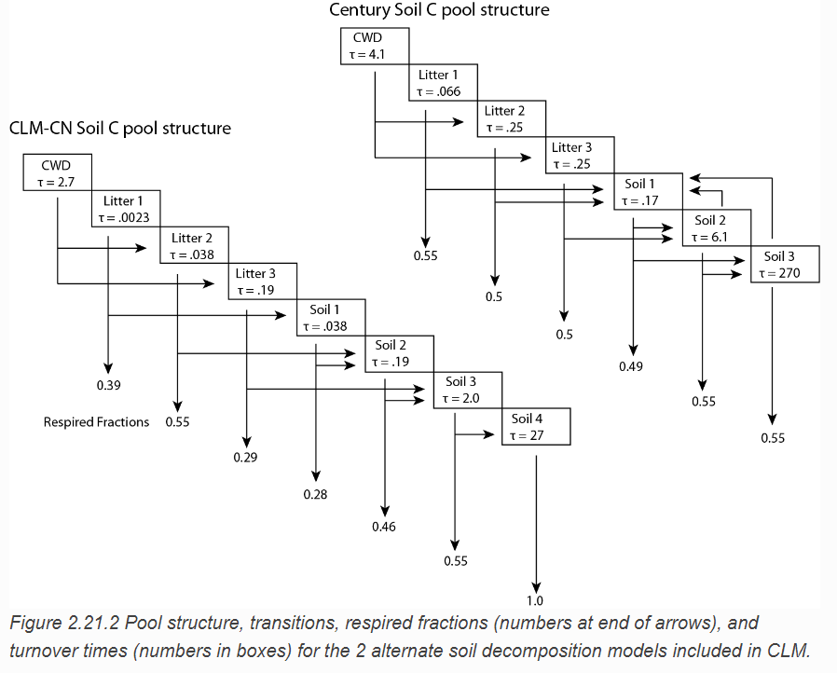
Additional resources
Two submodels for decomposition
Notes:
CLM allows the user to define, at compile time, between 2 contrasting hypotheses of decomposition as embodied by two separate decomposition submodels: the CLM-CN pool structure used in CLM4.0, or a second pool structure, characterized by slower decomposition rates, based on the fCentury model (Parton et al 1988).

Slide 30

Additional resources
NCAR Workshops
https://ncar.ucar.edu/opportunities/workshops-conferences

Slide 31
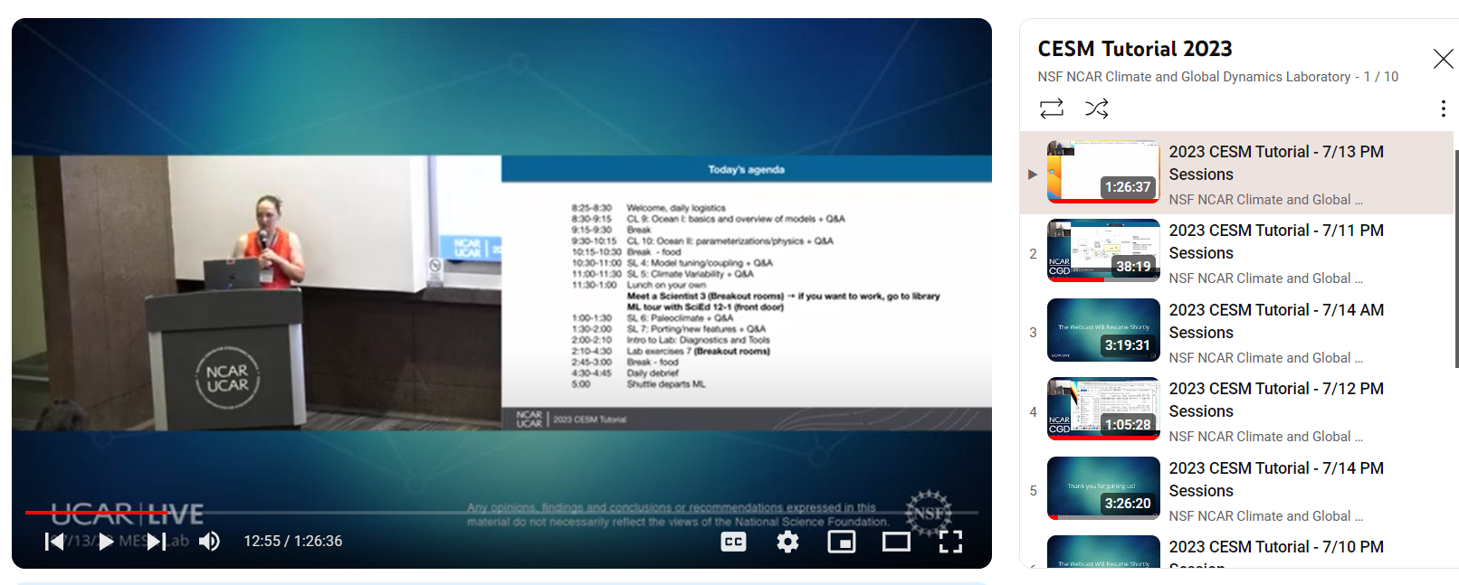
Additional resources
NCAR CGD Youtube Channel
https://ncar.ucar.edu/opportunities/workshops-conferences

